Slide 1
ARGO Project
By Axel Amzallag, Tim Kalnins, and Josh Hug

Slide 2
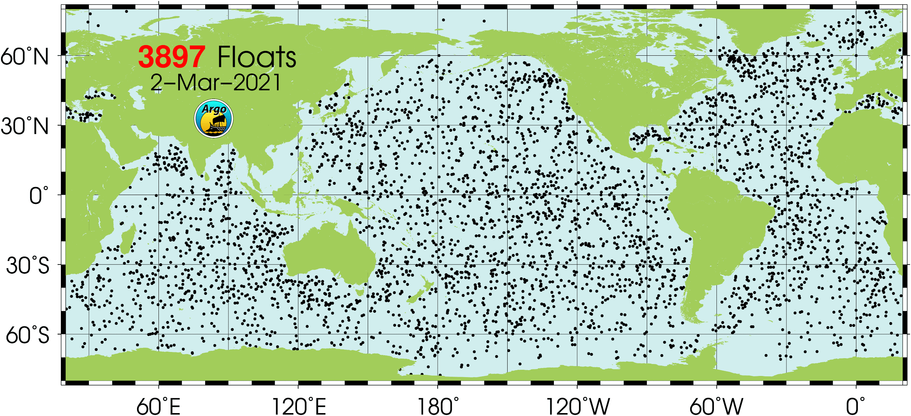
ARGO: What, Where, When
ARGO is a system of buoys that go down into ocean and measure temperature, salinity, and other variables of ocean water. They are found all over the globe.
The buoys are down for ~10 days, and can drift up to 100 kilometers on each dive.
After their drift, buoys begin an ascent, during the ascent measurements such as temperature, pressure (a proxy for depth), and salinity are taken
After the ascent the buoys surface and relay all of the data via satellite before beginning the cycle again

Slide 3
What is a .nc File?
The netCDF file format (.nc) is a standard format used for meteorological and oceanographic data. Can’t read into R in a standard way. Package: ncdf4
Documentation is easy to find. The ARGO project has a 110 page User Manual, and the NetCDF data format has a Standard Conventions Manual as well.
There are 64 variables per buoy. Some are metadata (1 entry per dive) while others contain greater than 1000 entries.
Some variables include metrics of quality for the data collected, allowing us to ensure that we are using data that is accurately measured.
Using specialized functions in the ncdf4 package, you can pull out the cells that you need and leave the others.

Slide 4
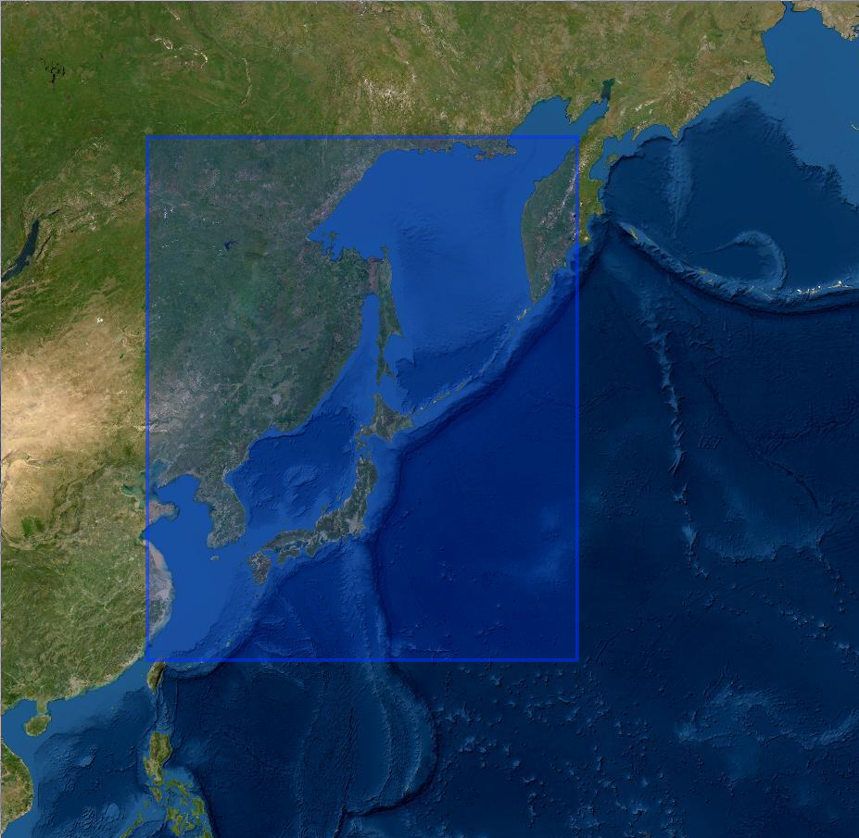
Location, Location, Location
Korean Peninsula and Japan up to Russia’s eastern seaboard.
Heavy fishing industry means high potential economic impact of changing ocean.
High geopolitical significance due to international importance of neighboring countries.
Large range of climate zones.
High amounts of seismic and cyclone activity in this region.
Russia
Russia
Russia
China
Korea
Japan
China

Slide 5
Data Download
Once received by satellite, float data is transferred to data assembly centers, following a quality control procedure and NetCDF formatting, float data is then uploaded to various public facing ftp and https servers.
On these servers data is organized into three “views”: GEO (by geographical), DAC (by data assembly center), LATEST_DATA (by time). Each view contains the same data, but offers users different data groupings for parsing.
Since we have a geographic domain restriction, we utilized GEO view for scraping purposes.
A simple bash script, using the wget utility, was used to iterate over subdirectories and download all pertinent NetCDF files corresponding to float data gathered from the Pacific Ocean.

Slide 6
Cleaning and Formatting
The ARGO Project reviews the files periodically and keeps them standardized, so data collecting/cleaning can be automated without fear of losing data.
Our data pipeline consists of functions that take in multiple netCDF files then appropriately subset to any specified latitude and longitude and then select any specified measurements taken by the buoys.
We create two data frames via this process, one contains the key variable data the other contains the measurements taken on ascent.
These functions are very easy to modify input wise so that we can select any geographic region and any variables that are available easily.
NetCDF Read-In (64 Variables/Dive)
Filter in R (5 Location/Time/Buoy Variables and 3 Covariates)
Key Vars CSV (1 Row/Dive)
Covariate CSV (Many Rows/Dive)
Key Variable Data
Measurement Data
The Covariate CSV
1 row per observation of measurement data, with a unique key of Julian Date and buoy number
1 row per buoy/date pair
1 column per buoy/date pair

Slide 7
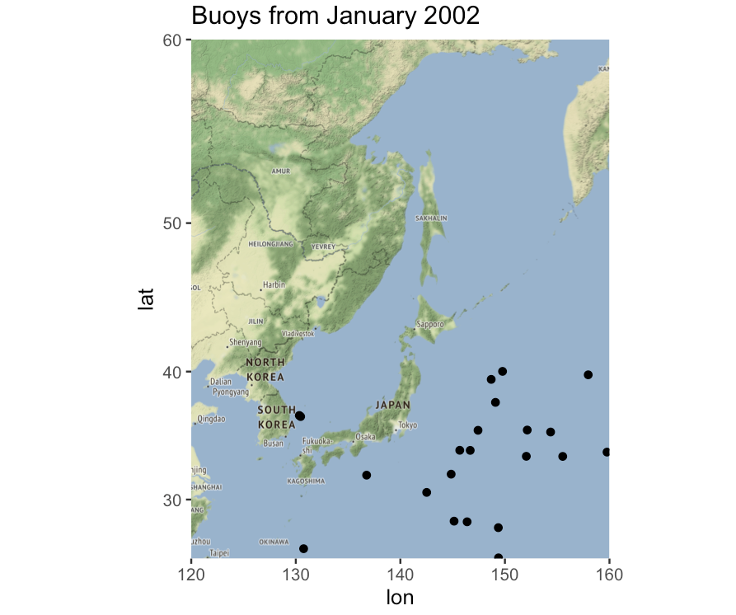
Lots of Data: How Much is Useful?
Around 80% of buoys that are recorded as having surfaced in these files have recorded NA’s for all their measurement data
Typically, only a few dozen buoys come up in our area per month.
Lots of empty space between data points, which we will have to take into account in some fashion.
Natural weather patterns, such as seasonal variation, should be taken into account. Correlation between different seasons is not necessarily helpful.
We have data over many years, and more recent years have more buoys.
It appears that there are little to no buoys in the sea of Okhotsk

Slide 8
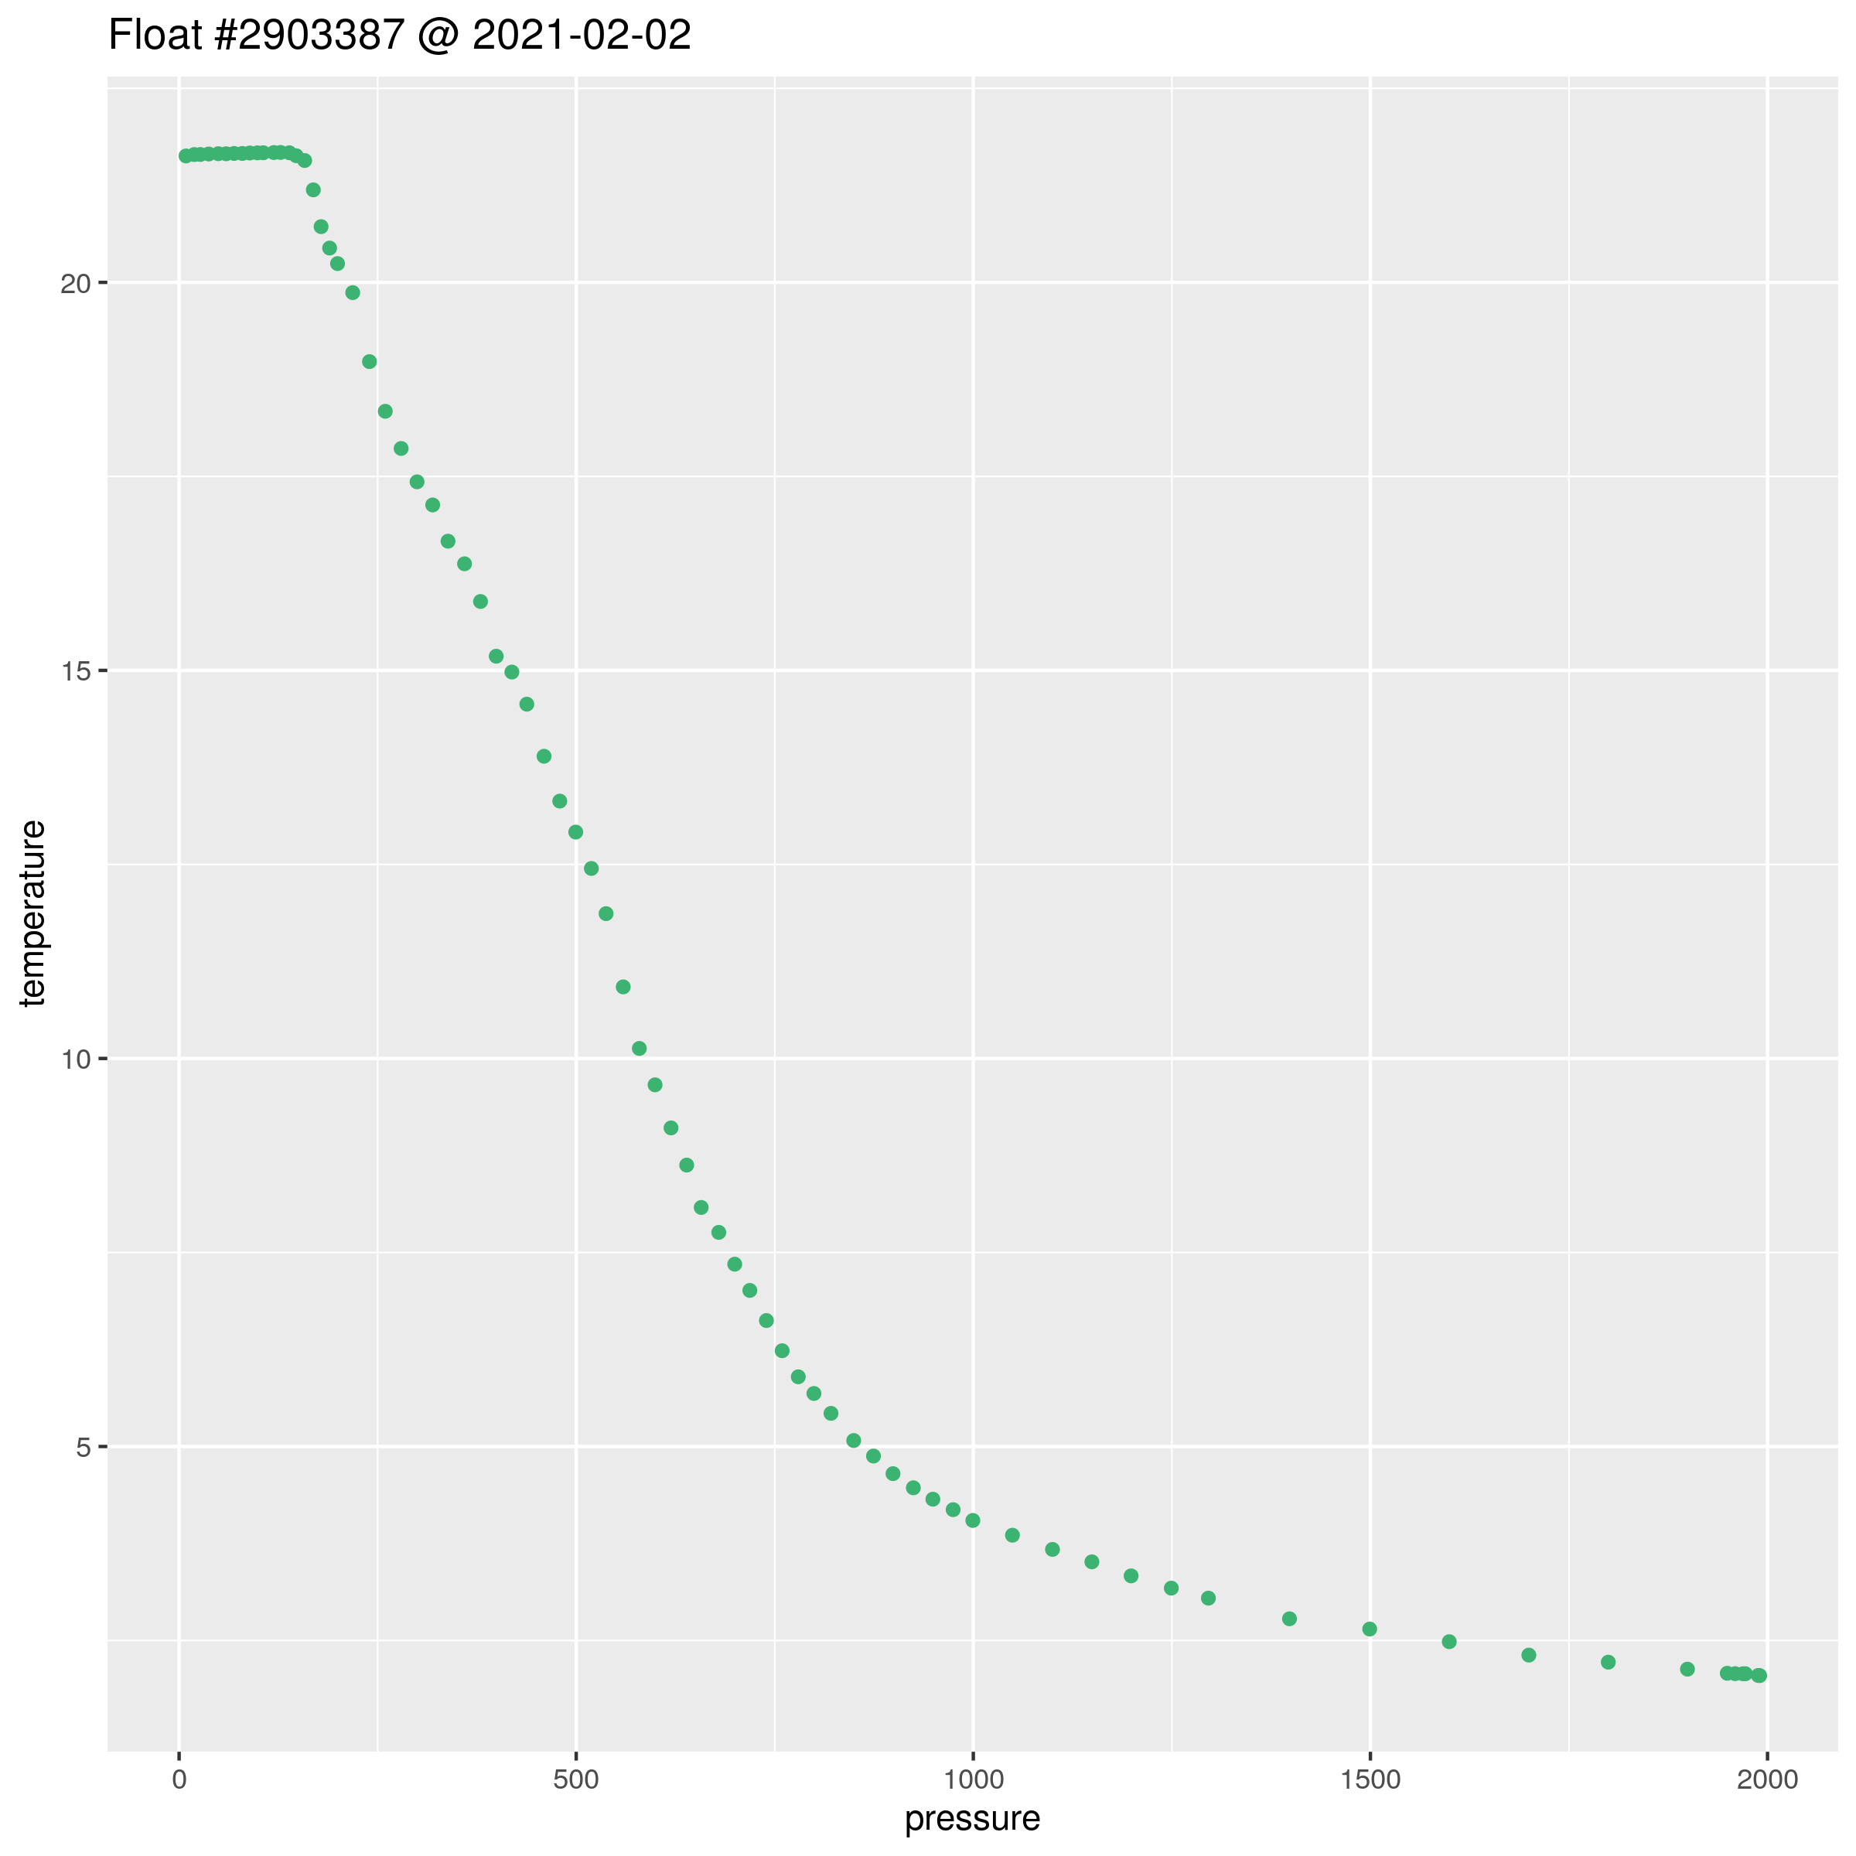
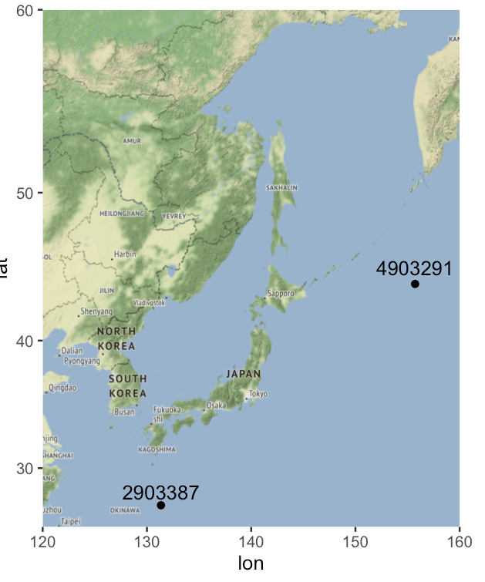
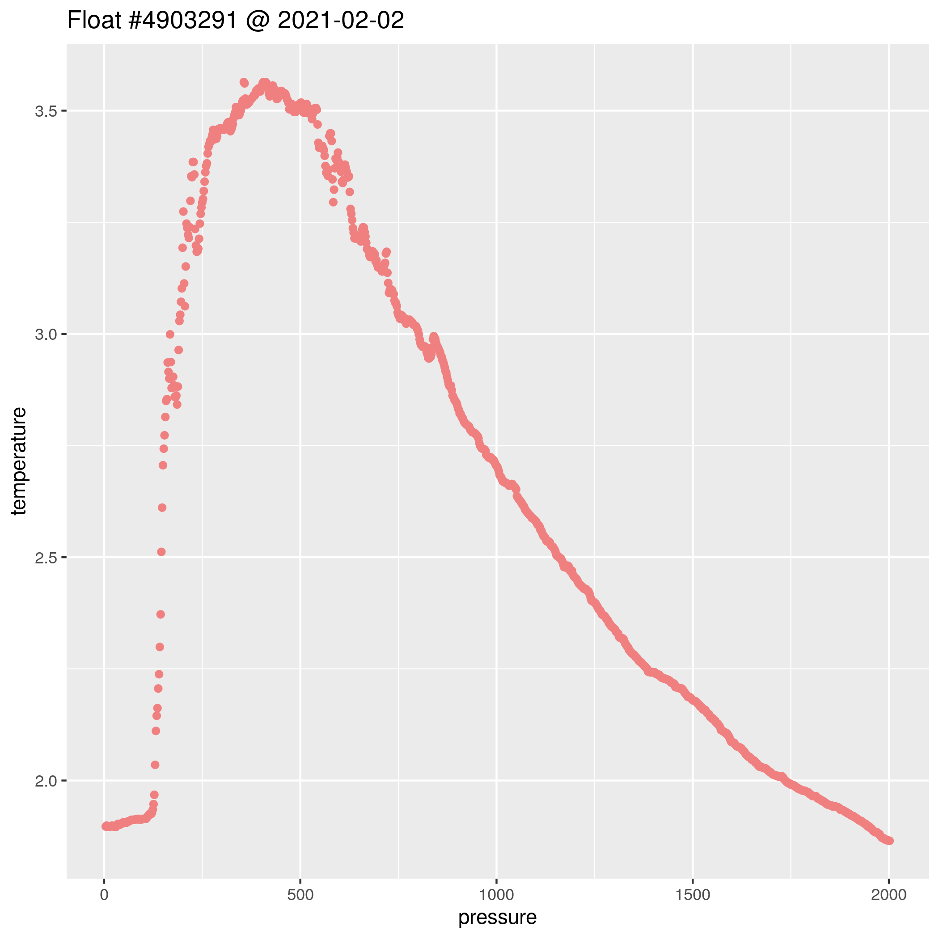
Two Examples of Single Buoys

Slide 9
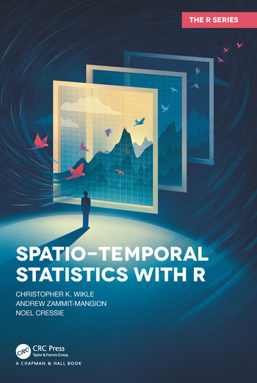
Statistics in Spacetime
We were able to find a helpful textbook for spatial statistical modeling. There are also helpful Youtube lectures/videos dedicated to Geostatistics.
Bayesian inference can be used to help fill in empty spaces between points with a prior. Regression is common with spatial data. GLMs, Gaussian processes, lots of typical statistical practices.
Other commonly used statistical methods for spatial data are variograms and kriging: more research needed.
There are some helpful R packages for data analysis and visualization: fields, gstat, ggquiver, ggmap, and sp (for Spatial).

Slide 10
Potential Future Goals and Objectives
One of our main upcoming goals is to create interactive data visualization (a shiny app) showcasing the changes in ocean temperatures over the period 2002-2021. Another focus might be the temperature range of certain fish that are important to the local diet/economy.
Detect temperatures outside the norm, and focus on any correlation to periodic weather events (El Niño or some similar cyclical climatic event)
We could also make a visualization showing the depth of the beginning of the thermocline at different points in the ocean. Or make a 3D visual of the thermocline.
Model fitting and prediction:
Compute correlation length scales between buoys
Construct a mean-field of oceanic surface temperatures based on some time scale
Estimate the spatial distribution of thermocline depth

